Slide 1
Rang a hAon
27ú Aibreáin- 1d Bealtaine 2020

Slide 2
Gaeilge
Éist leis an scéal agus cur scríobh amach
na freagraí cearta do na ceisteanna.
Listen to Múinteoir Donna reading the story and
Then write out the answers to the questions.
Get the full story and PDF including questions at the link below
https://www.cogg.ie/wp-content/uploads/19.Ainmhithe-sa-Choill-asal.pdf
Tarraing pictiúr dar teideal Ainmhithe sa Choill. Cur an Iora Rua, gráinneog agus sionnach ann.

Slide 3
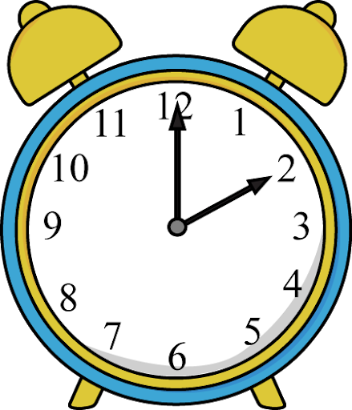
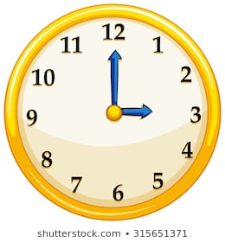
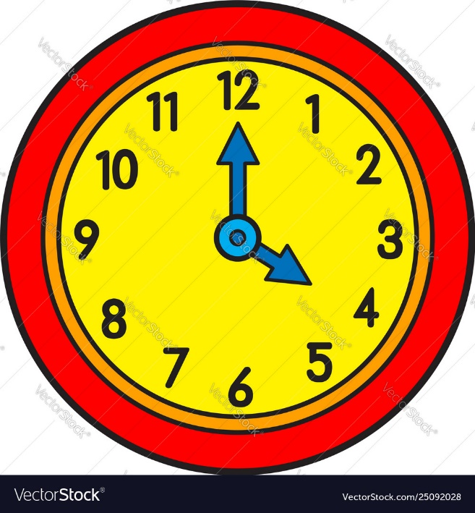
Mata
Nuair atá an lámh fhada ag a 12 agus an lámh ghairid ag uimhir eile , tá sé ____ a chlog.
3 a chlog 4 a chlog 2 a chlog

Slide 4
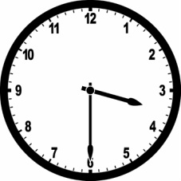
Mata
Nuair atá an lámh fhada ag a 6 tá sé leath uair tar éis ______.
Oibríonn muid amach cén uair, ag féachaint ar an dá uimhir atá an lámh gairid idir agus ag baint úsáid as an uimhir is lú.
When the big hand is at 6: we know that its half past _____.
We figure out the hour by looking at the two numbers that the hand falls between and choosing the smaller of the two numbers or the number that is before the small hand.

Slide 5
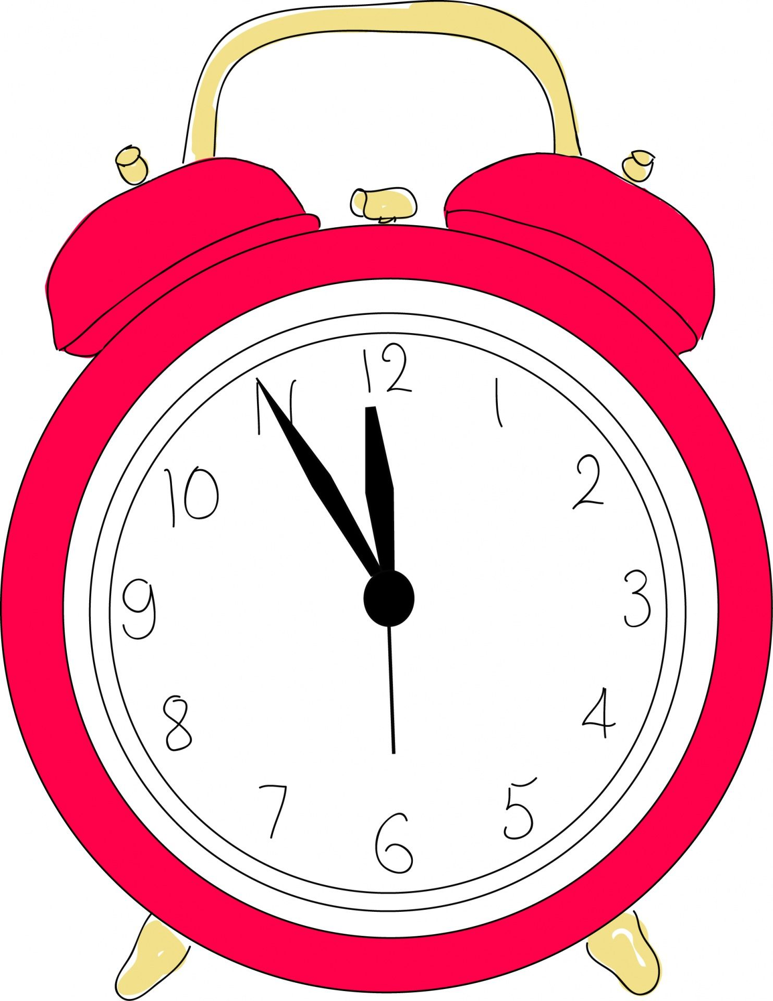
Poetry
The clock
I’m in the clock crew and I’m okay!
I tick all night and I tick all day.
I’ve got two hands, I’m having a ball,
Because I’ve got no arms at all!
My big hand can move sixty minutes in one hour,
I’m the one with the strength and the power.
My small hand isn’t quite as fast.
If they were in a race, it would come last!
It takes so long just to get around (12 hours you know),
It’s careful, small and slow.

