Slide 1
Iolrú/Méadú
Rang 3- AN Chéadaoin 20ú

Slide 2
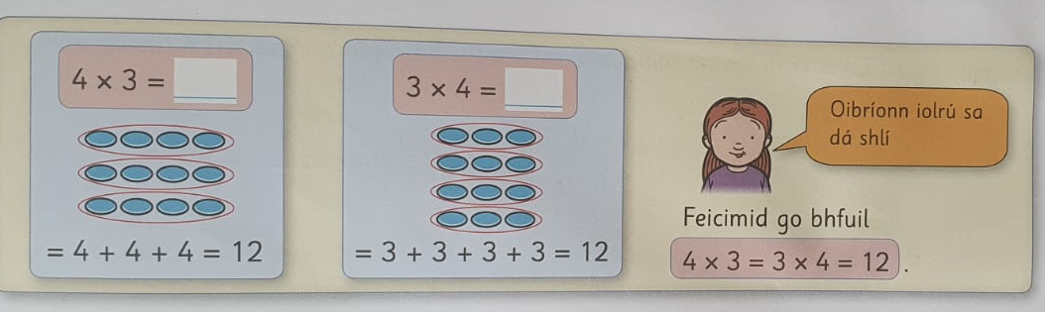

2.
4
x 3
12
3
x 4
12
4 x 3 = 3 x 4 = 12
A. 5 x 6 = 6 x 5 = 30
5
x 6
30
6
x 5
30
1.

Slide 3
32
4 | 8
4 x 8 = 8 x 4 = 32

Slide 4
54
9 | 6
__ x __ = __ x __ = ___

Slide 5

54
9 | 6
Maith thú!
9 x 6 = 6 x 9 = 54

Slide 6

7 x 3 =

Slide 7
7 x 3 =
7 x 3 = (___ x 3) + ( __ x 3) =
4 + 3
5 + 2
6 + 1

Slide 8
7 x 3 =
7 x 3 = ( 4 x 3) + ( 3 x 3) =
4 + 3
5 + 2
6 + 1
12 9
12 + 9 =

Slide 9
7 x 3 =
7 x 3 = ( 4 x 3) + ( 3 x 3) = 21
4 + 3
5 + 2
6 + 1
12 9
12 + 9 = 21

Slide 10

7 x 3 = 21
7 x 3 = ( 4 x 3) + ( 3 x 3) = 21

