Slide 1
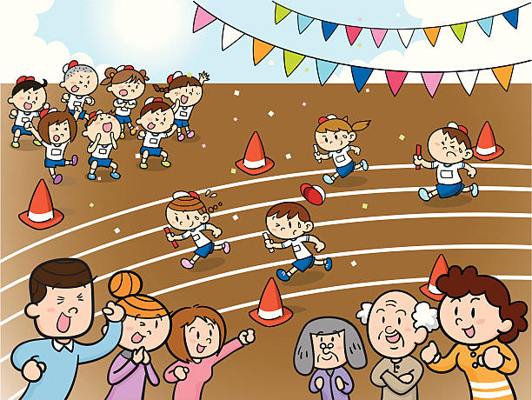
Rang a hAon
2-5ú Meitheamh- 2020

Slide 2
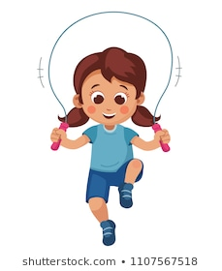
Clós na Scoile
https://www.cogg.ie/wp-content/uploads/9.Cl%C3%B3s-na-scoile-asal.pdf
Éist leis an scéal “Clós na Scoile” agus freagair na ceisteanna.
Déan pictiúr duit féin ag súgradh sa chlós le do chairde.

Slide 3
Phonics: Compound Words
Listen to Múinteoir Donna reminding you what a compound word is and then complete the exercises:
Combine two words to make a compound word: USE THE PICTURES AS A CLUE!
Read the compound words and find the two smaller words inside them: split the compound words into 2 separate words.

