Slide 2
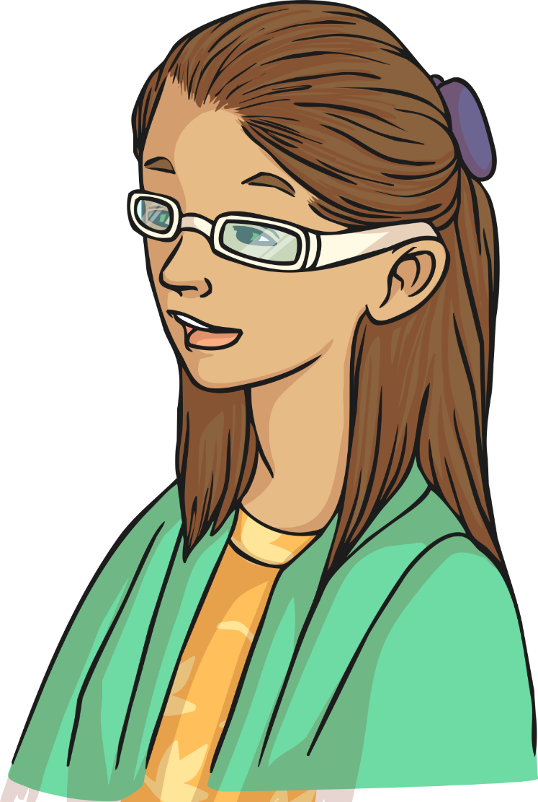
What is the European Day of Languages?
The European Day of Languages was first set up by the European Council in 2001. Now, it takes place every year on 26th September.
It celebrates and promotes language learning and linguistic diversity.

Slide 3
Why celebrate languages?
Did you know that there are more than 200 European languages alone.
In addition, there are many other languages that are spoken within Europe.

Slide 4
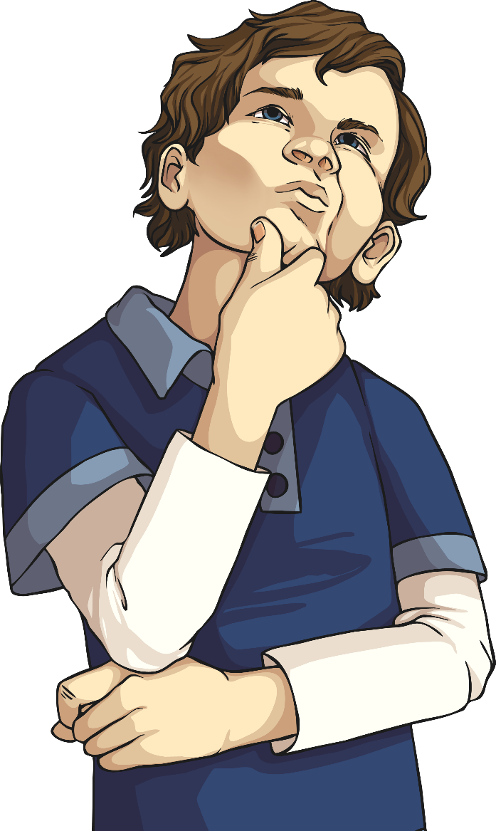
Why celebrate languages?
250
London
How many languages are spoken in London?
There are around 250 different languages that are spoken in London alone!

Slide 5
Why learn languages?
What language(s) can you speak?
Do you think learning different languages is important?
Bonjour
Hello

Slide 6
Why learn languages?
Being able to speak different languages can help you to:
make new friends;
travel and study abroad;
live and find work in different countries;
understand different cultures.

Slide 7
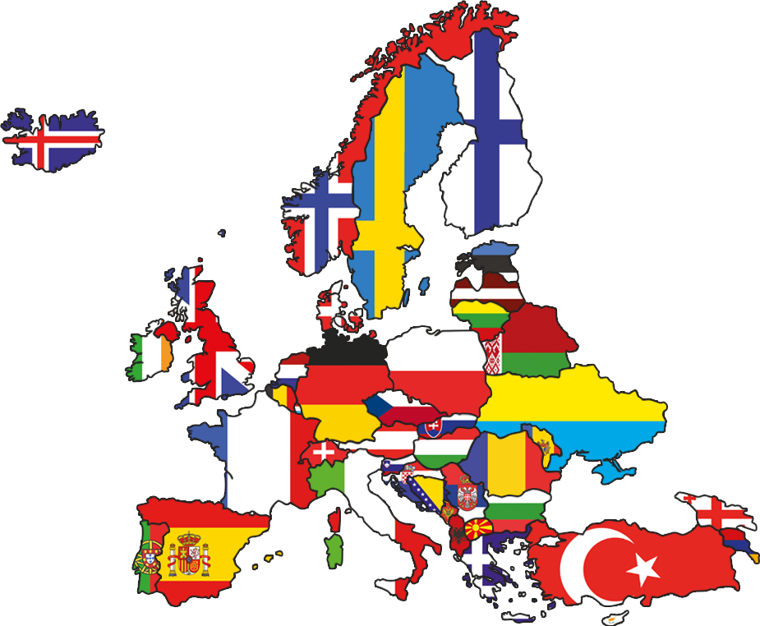
What happens on the European Day of Languages?
There are events and celebrations taking place across many countries in Europe.
Activities include fairs, conferences, school events, workshops and language taster sessions.

Slide 8
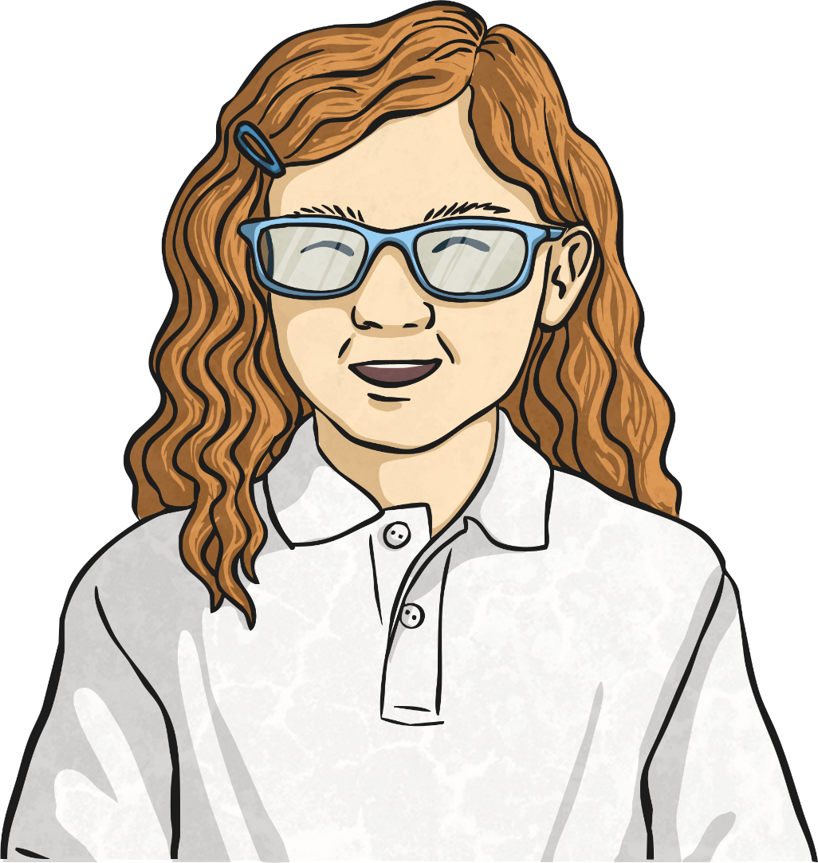
Saying ‘Hello’
Saying hello in different European countries.
Can you guess the following language?

Slide 9
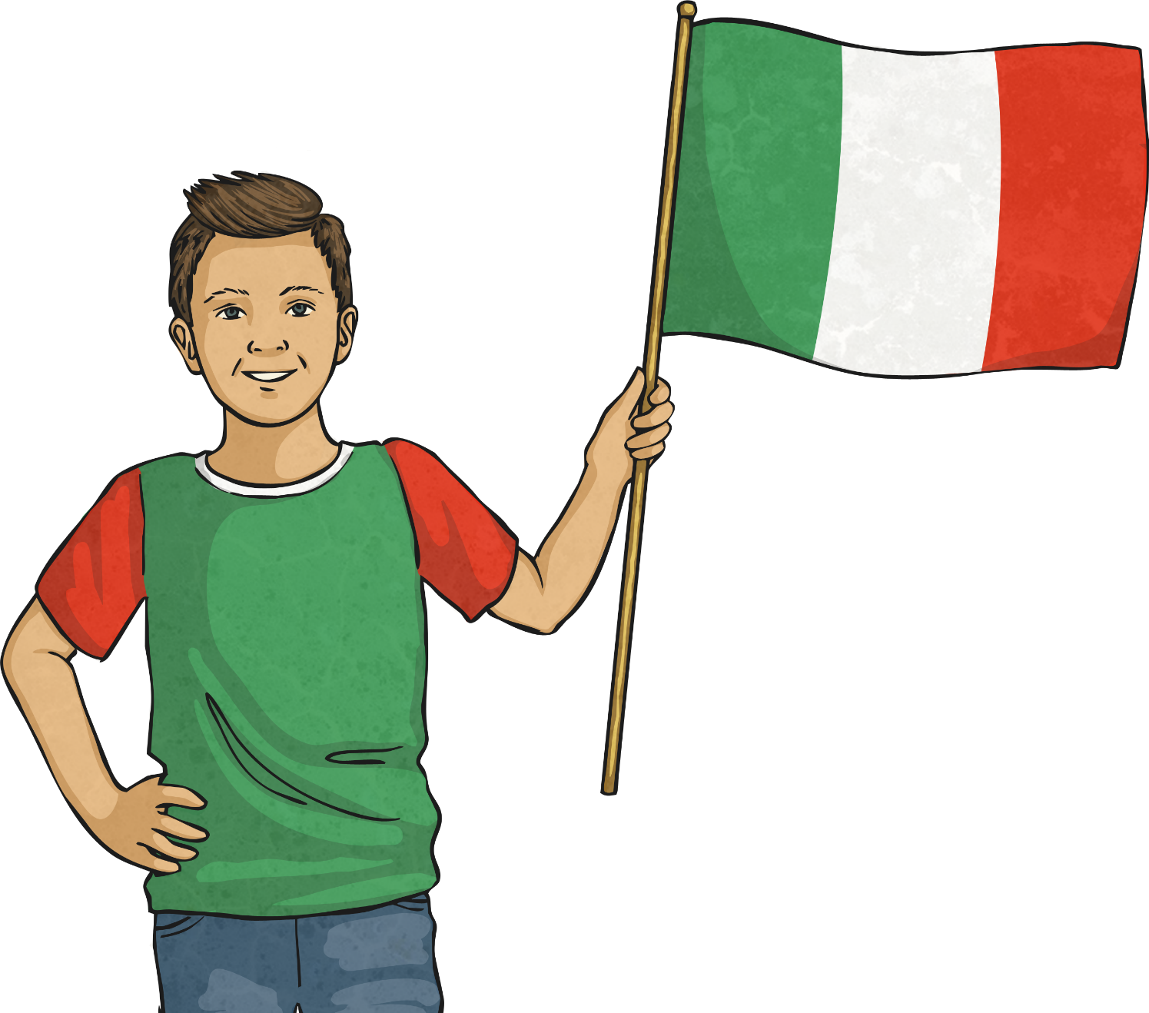
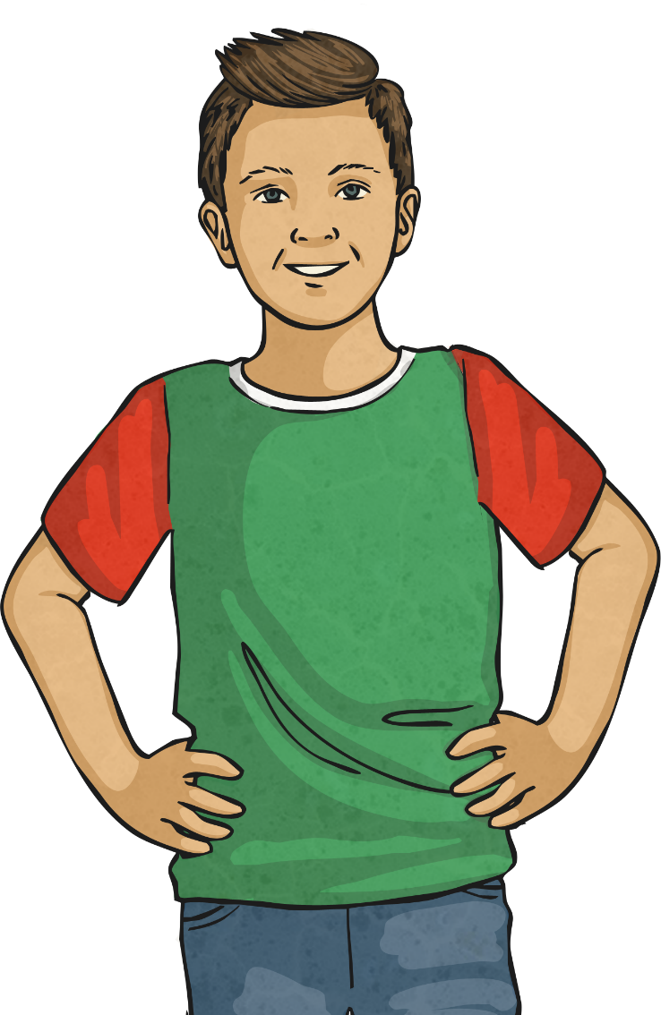
Ciao!
‘Ciao’ means ‘hello’ in Italian!

Slide 10
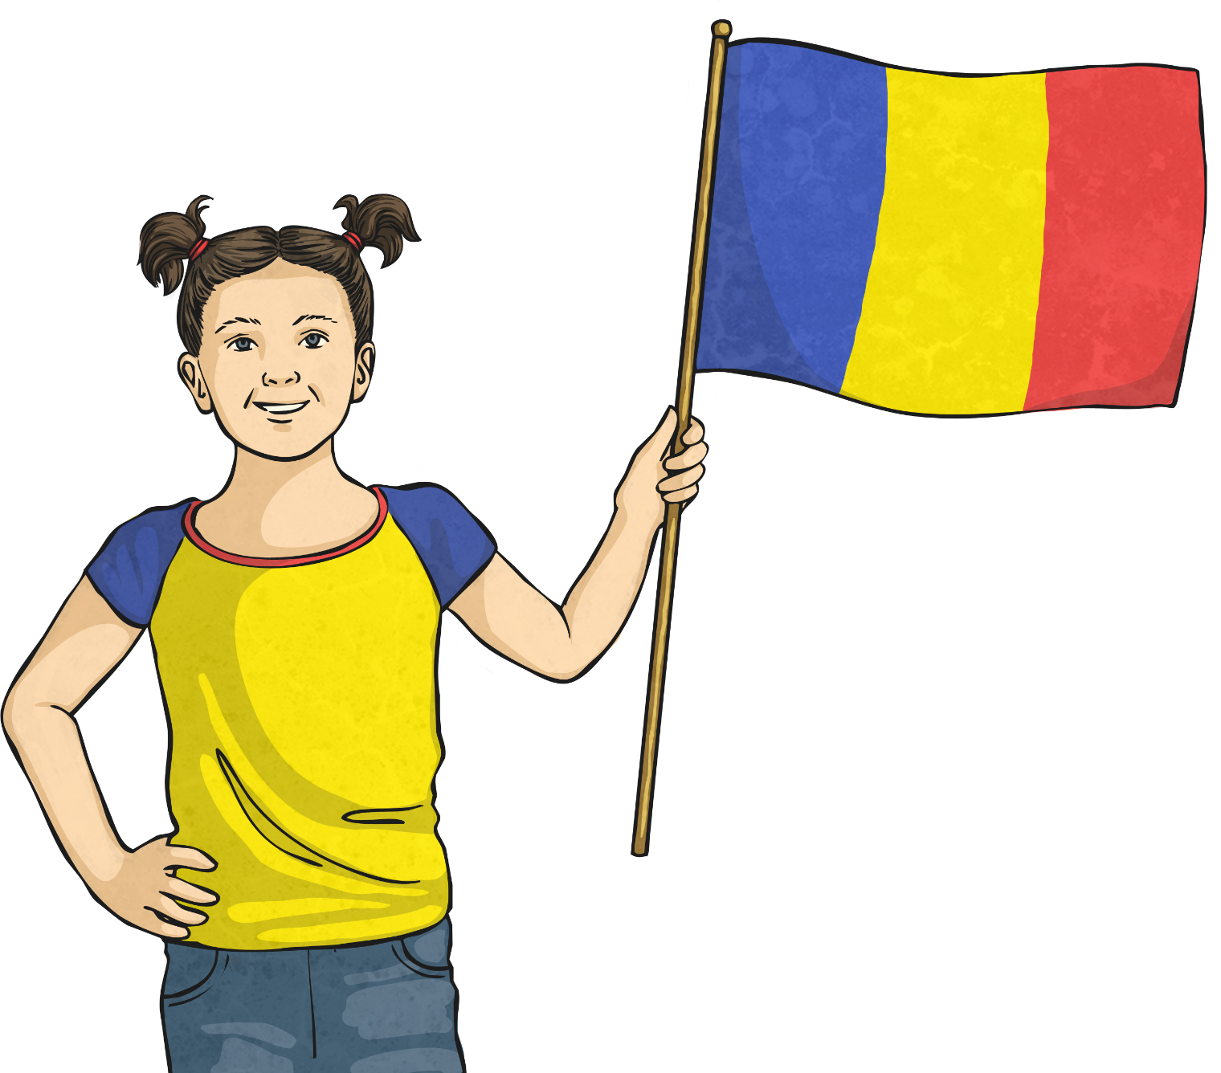
Buna!
‘Buna’ means ‘hello’ in Romanian!

Slide 11
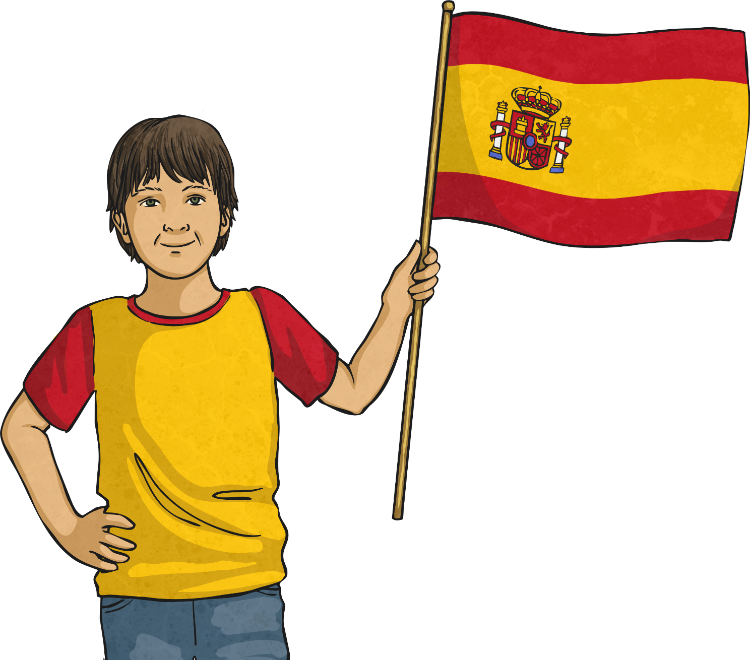
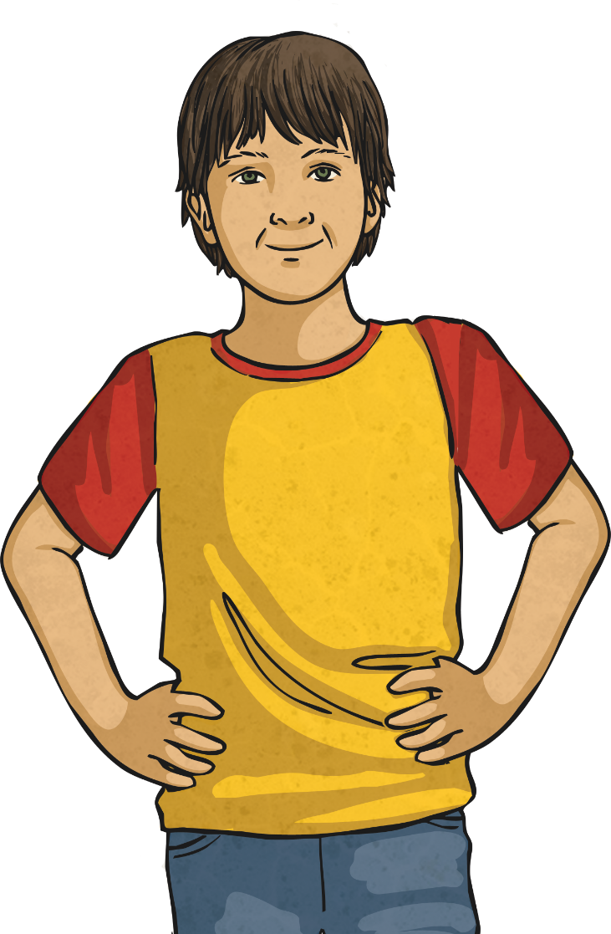
¡Hola!
‘Hola’ means ‘hello’ in Spanish!

Slide 12
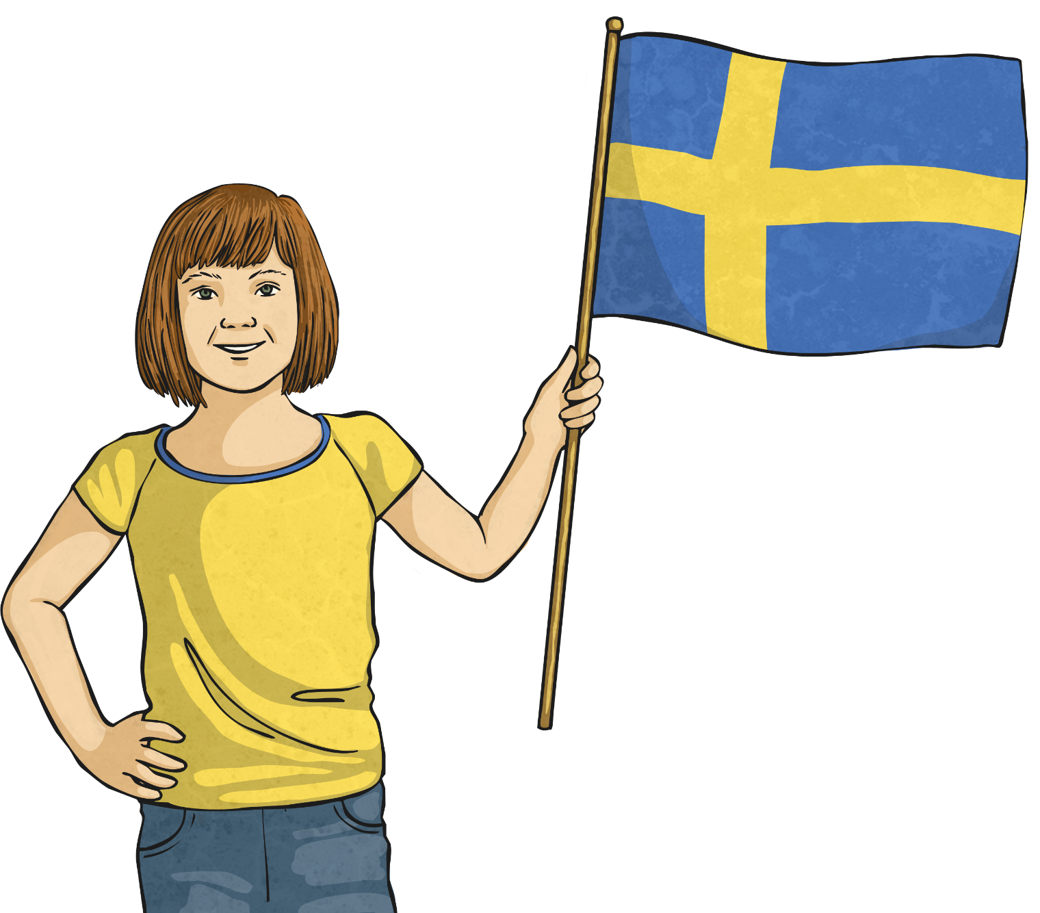
Hallå!
‘Hallå’ means ‘hello’ in Swedish!

